Slide 1
Machine Learning
Data Preparation

Slide 2

Previous Day Recap
Duration - 2 minutes.
Interactive Discussion

Slide 3
Module Objectives
After completing this course you will be able to:
Understand the centrality of data in machine learning
Understand the importance of having data of good quality
Explain what data preparation is
List the different steps involved in data preparation
Describe some techniques used in each step

Slide 4
Learning From Data
Traditionally, we only use data for either input or output
A traditional algorithm is designed to do just one thing
What if you want to teach it new behaviours?
Let’s take a step back …how do you learn new things?

Slide 5
Learning From Data
Traditionally, we only use data for either input or output
A traditional algorithm is designed to do just one thing
What if you want to teach it new behaviours?
Let’s take a step back …how do you learn new things?
By watching other people
By trying
By failing
Also, by succeeding

Slide 6
Learning From Data
The way an algorithm learns is not very different from the way you learn
It needs examples …
… possibly with associated outcomes
What works vs. what doesn’t work
Or, quantitative outcomes (how well it works)
This means data, plenty of data
The more the data, the better the prediction
By feeding an algorithm data, we build a model
An algorithm that has yet to see any data can’t make any prediction

Slide 7
Data Preparation
Data needs to be prepared before it can be used
This is a huge step in the overall ML process
It can very well take up a majority of the invested time and efforts
Data preparation itself consists of several steps:
Data specification
Data ingestion and integration
Data cleansing
Data selection
Feature Selection
Data wrangling
Notes:
https://en.wikipedia.org/wiki/Data_pre-processing
https://en.wikipedia.org/wiki/Data_preparation
https://en.wikipedia.org/wiki/Data_integration
https://en.wikipedia.org/wiki/Data_cleansing
https://en.wikipedia.org/wiki/Data_reduction
https://en.wikipedia.org/wiki/Instance_selection
https://en.wikipedia.org/wiki/Feature_selection
https://en.wikipedia.org/wiki/Data_wrangling

Slide 8
Data Specification
It is step zero of the data pipeline, where you (the developer) must:
communicate with all the stakeholders, including:
Predictive analytics team (if separate from data prep team)
End users of the ML model:
Other teams in the same company (for internal analyses)
Clients
consider:
Any available specification of the system where the data is analysed
All the information available (including gaps, typos, inconsistencies, …)
define the name, format and meaning of each data field

Slide 9
Data Ingestion and Integration
Data is typically scattered across different locations, due to one or more of :
Diversity of sources
internal, third party, the web, any kind of environmental sensor
Variety of use cases:
staging, reporting, visualization, advanced analytics, machine learning
Company mergers
Data also comes in different formats:
Structured (relational database tables)
Semi-structured (CSV, logs, XML, JSON, …)
Unstructured (text files, Word documents, Pdfs, emails, …)
Binary (images, audio, video, …)

Slide 10
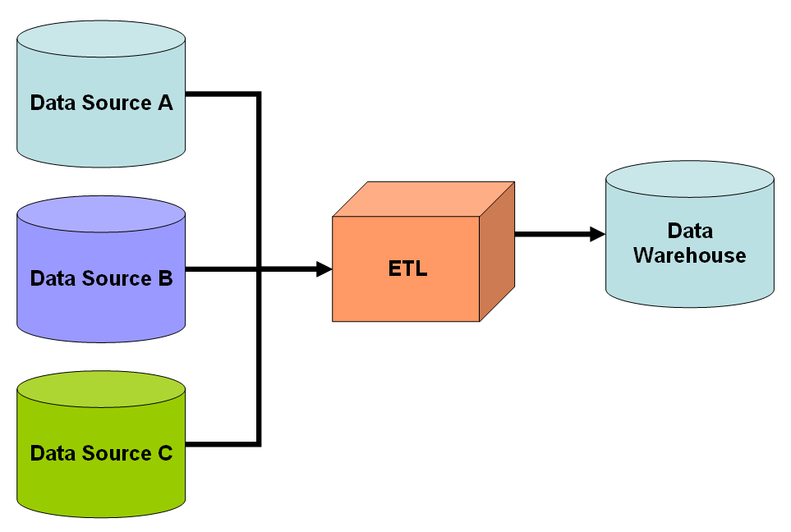
Data Ingestion and Integration
ETL is a common technique used to:
Extract data from various original locations;
Transform it to comply to some predefined uniform schema;
Load it into its destination (a data warehouse, a data lake, or on the cloud)
Advantages:
Data in one location
Faster queries
Disadvantages:
Frequent updates require continuous synchronization;
Creation of data swamps
Notes:
Note that the data swamp criticism only applies to data lakes (whether they are on the cloud or not). This is because a data lake is typically a storage system where a wide range of data formats may coexist, whereas a data warehouse is by definition more structured.
“A data swamp is a deteriorated and unmanaged data lake that is either inaccessible to its intended users or is providing little value”
(Olavsrud, Thor. “3 keys to keep your data lake from becoming a data swamp”. CIO)
“We see customers creating big data graveyards, dumping everything into Hadoop distributed file system (HDFS) and hoping to do something with it down the road. But then they just lose track of what’s there. The main challenge is not creating a data lake, but taking advantage of the opportunities it presents.”
(Stein, Brian; Morrison, Alan (2014). “Data lakes and the promise of unsiloed data”. Technology Forecast: Rethinking integration. PricewaterhouseCooper.)
Successful data lakes gradually mature as the company figures out which data and metadata are important.

Slide 11
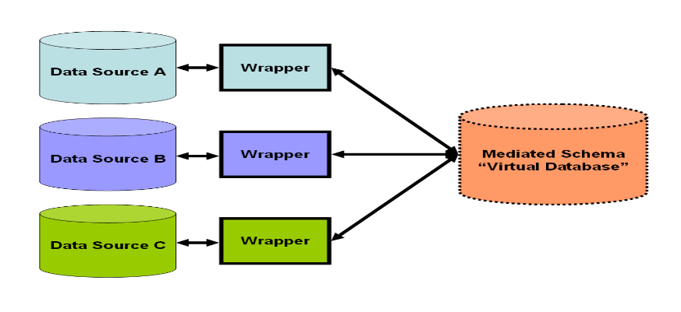
Data Ingestion and Integration
Another common technique is known as virtual data integration
A virtual database presents a unified view of the data;
A system of wrappers converts queries on the virtual db into queries on the data sources;
The corresponding architecture is known as data hub
Advantages:
Real-time updates
No need for ETL
Disadvantages:
Slower queries (e.g. joins);
Creation of data silos
Notes:
A data hub is a collection of data from multiple sources organized for distribution, subsetting and sharing. Generally this data distribution is in the form of a hub and spoke architecture.
A data hub differs from a data warehouse in that it is generally unintegrated and often at different grains. It differs from an operational data store because a data hub does not need to be limited to operational data.
A data hub differs from a data lake by homogenizing data and possibly serving data in multiple desired formats, rather than simply storing it in one place, and by adding other value to the data such as de-duplication, quality, security, and a standardized set of query services. A Data Lake tends to store data in one place for availability, and allow/require the consumer to process or add value to the data.
Data Hubs are ideally the "go-to" place for data within an enterprise, so that many point-to-point connections between callers and data suppliers do not need to be made, and so that the Data Hub organization can negotiate deliverables and schedules with various data enclave teams, rather than being an organizational free-for-all as different teams try to get new services and features from many other teams.
=> TODO: Add slide on Data hub vs. data warehouse vs. data lake
=============================================================================
The term data silo refers to the isolation of distinct data sources, which makes it possible for the same information to be duplicated. An approach to handle this issue is to use commonality relationships. Commonality relationships are peer-to-peer relationships between standardized data entities of multiple data models. By keeping track of duplicates, they enable joins and other forms of data merging.
Issues still arise with return sets which are inaccurate, incomplete or impossible to validate. One solution is to support commonality constraints where referential integrity may be enforced between databases.

Slide 12
Data Cleansing
Data cleansing is the process of obtaining high quality data from possibly dirty or coarse data
High quality data is defined by the following criteria:
Validity
It satisfies constraints (data type/range, uniqueness, FK, reg. exp. patterns, …)
Accuracy
Does it conform to true value? (true value may be unknown)
Completeness
Almost impossible to fix (unless going back to the source)
Consistency
Distinct data items do not contradict each other
Uniformity
Same unit of measure used across systems
Notes:
When data is corrected (but not removed), we can speak of data editing:
https://en.wikipedia.org/wiki/Data_editing

Slide 13
Data Cleansing – How It Works
The data cleansing process may be split up into three separate steps:
Data auditing
It uses statistical methods
It gives an indication of the presence of anomalies, their type and location
Correction
Multiple anomalies require a workflow specification - techniques include:
Removing incorrect/duplicate entries;
Replacing incorrect / missing values with default / mean / median / …
Post-processing
Inspect results to check for correctness

Slide 14
Exercise 1
Research different data cleaning techniques
Duration - 15 minutes.
Discussion & Feedback.

Slide 15
Data Selection
Data entry removal may be required not just for cleaning purposes
Data needs to be carefully selected to provide a faithful representation of the overall population
Selection bias occurs when a particular group is either over- or under-represented
Data reduction is a special case of data selection
The aim is to reduce the size without losing information
Many algorithms are available
A use case is data reduction in the Kepler satellite
Generated data is orders of magnitude more than the downlink bandwidth
First, only meaningful parts of an image are selected
Then data reduction algorithms are applied
Wearable devices may also apply data reduction algorithms

Slide 16
Feature Selection
Wide tables have up to hundreds of thousands of attributes (features), thus being intractable
Feature selection aims to reduce data dimensionality by discarding features which are either:
Irrelevant for the purposes of the analysis, or
Redundant (i.e. highly correlated to some other feature)
Benefits include:
Model simplification, for easier interpretation of the results
Faster training
Avoiding the curse of dimensionality, namely:
Data points becoming sparse and dissimilar as dimensions increase
Data required to maintain density increases exponentially
May cause overfitting, or even make analysis impractical

Slide 17
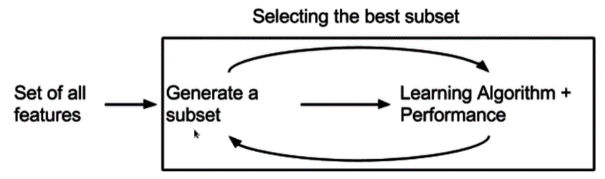
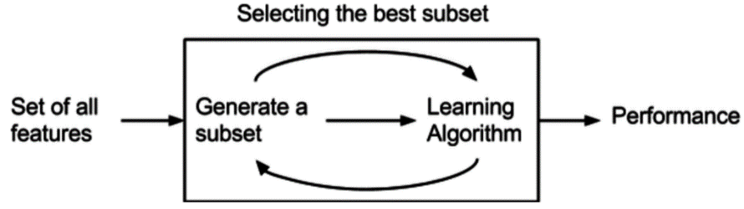
Feature Selection – How It Works
Several subsets of features are evaluated for suitability and the best one is chosen
Criteria for selection incorporate a measure of accuracy, penalised by the number of features
Algorithms can be split into three categories:
Filters
Embedded
Wrappers
Notes:
Filters keep the selection of the subset (including its evaluation) separate from the learning algorithm. They are usually cheaper and tend to avoid overfitting, by having simpler evaluation criteria.
Wrappers evaluate each subset of features by running it against a learning model, but will then follow up with a separate training phase, once the features have been selected.
Embedded techniques are embedded in, and specific to, a model.
Advantages and disadvantages are hard to generalise, as each class actually contains many algorithms.
A separate concern is to decide when to stop searching for the best subset, since exhaustive search is too computationally expensive. One way is by locally optimizing some measure. Another one aims for the subset that maximizes the area projected by the dataset in lower dimensions (to get more variance).

Slide 18
Data Wrangling
Data wrangling is the process of mapping raw data into data suitable for some specific purpose
The transformations may apply to: values, records, fields, entities, …; they include:
extraction, parsing, joining, standardizing, augmenting, tagging, cleaning, filtering, …
As such, data wrangling overlaps with data cleansing
Data cleansing usually refers to an earlier data prep phase
Data wrangling happens later, targeting one or more downstream application:
Visualization and report creation
Analysis purposes
Model training
Further processing
Notes:
Feature extraction is another related phase, where new features may be obtained from existing ones by applying advanced analytical techniques. It tends to target a narrower range of applications, usually limited to uses in machine learning. Data wrangling is thus a broader term, both in range of use cases and in the diversity of transformations.

Slide 19
Module Review
How does the usage of data in machine learning differ from conventional programming?
What is the purpose of data specification? Who should be involved
What is virtual data integration?
How can high quality data be defined?
What are the possible benefits of feature selection?
What is the purpose of data wrangling?

Slide 20
Module Outcomes
You should be able to:
Understand how data is required for learning
Understand the concrete need to prepare data before use
Understand what data specification consists of
Compare approaches to using data that is scattered across different storage systems
Understand how raw data is modified through multiple steps

Slide 21
Questions

